Slide 1
HFA Progress and Updates
Consultative Meeting of National Disaster Platform on Feb 17, 2013
Jishnu Subedi
Institute of Engineering
Tribhuvan University

Slide 2
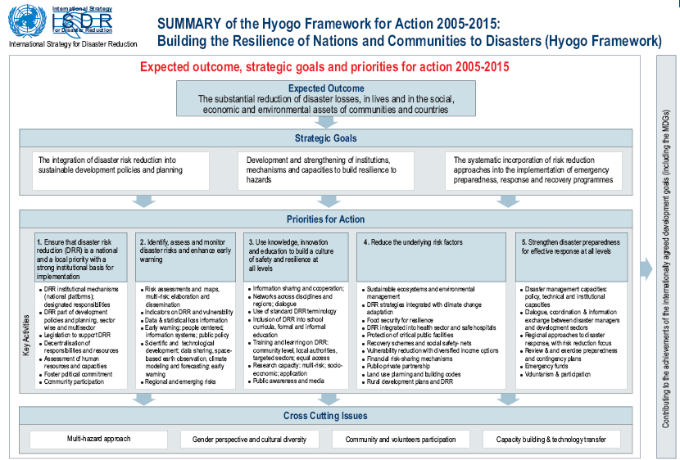
Hyogo Framework for Action
Expected Outcome
The substantial reduction of disaster losses of communities and countries
Emergency preparedness and response
DRR into development policy
Institution and capacity building
1
Make disaster risk reduction priority
2
Identify the risk and enhance early warning
3
Build Understanding and Awareness for Culture of Safety
4
Reduce the Underlying Risk
5
Strengthen Preparedness for effective response at all levels

Slide 3





Hyogo Framework of Action
Humanitarian
Development
Social
Technical
Political

Slide 4
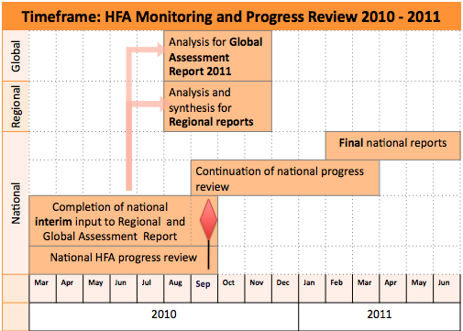
HFA: Monitoring and Review
MoHA as a focal desk for DRR completed the National HFA Progress Review (Interim review)

Slide 5
Level of achievement
Level | Generic Description of Achievement
5 | Comprehensive achievement has been attained, with the commitment and capacities to sustain efforts at all levels.
4 | Substantial achievement has been attained, but with some recognised deficiencies in commitment, financial resources or operational capacities.
3 | Institutional commitment attained, but achievements are neither comprehensive nor substantial
2 | Achievements have been made but are relatively small or incomplete, and while improvements are planned, the commitment and capacities are limited.
1 | Achievements are minor and there are few signs of planning or forward action to improve the situation.

Slide 6
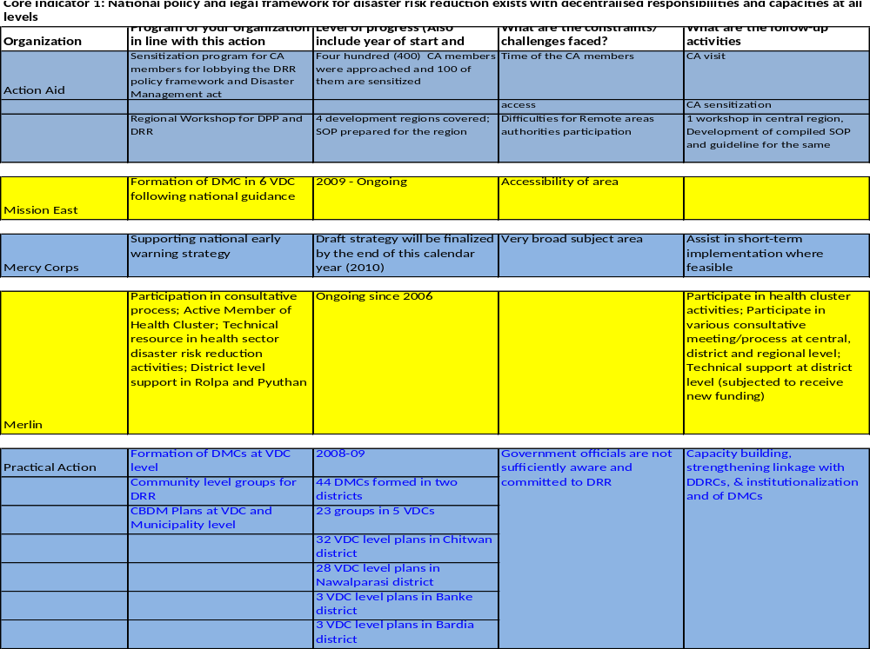
HFA Activity Mapping

Slide 7
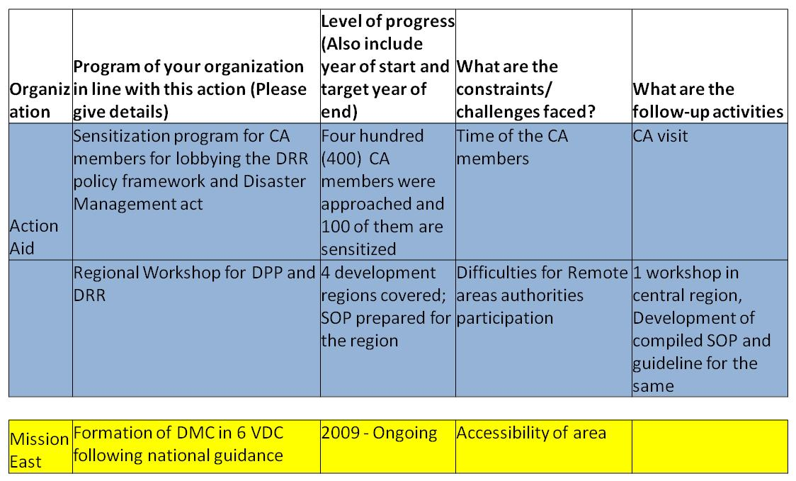
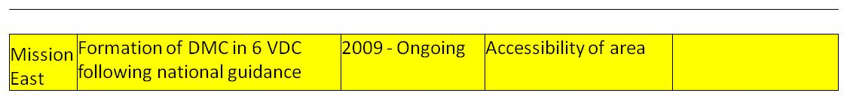
HFA Activity Mapping

Slide 8
Level of Progress
Priority for Action | Indicators | Level of Progress
PRIORITY FOR ACTION 1 Ensure that disaster risk reduction is a national and local priority with a strong | National policy and legal framework for disaster risk reduction exists with decentralized responsibilities and capacities at all levels | 3
 | Dedicated and adequate resources are available to implement disaster risk reduction plans and activities at all administrative levels | 2
 | Community participation and decentralization are ensured through the delegation of authority and resources to local levels | 3
 | A national multi-sectoral platform for disaster risk reduction is functioning | 3

Slide 9
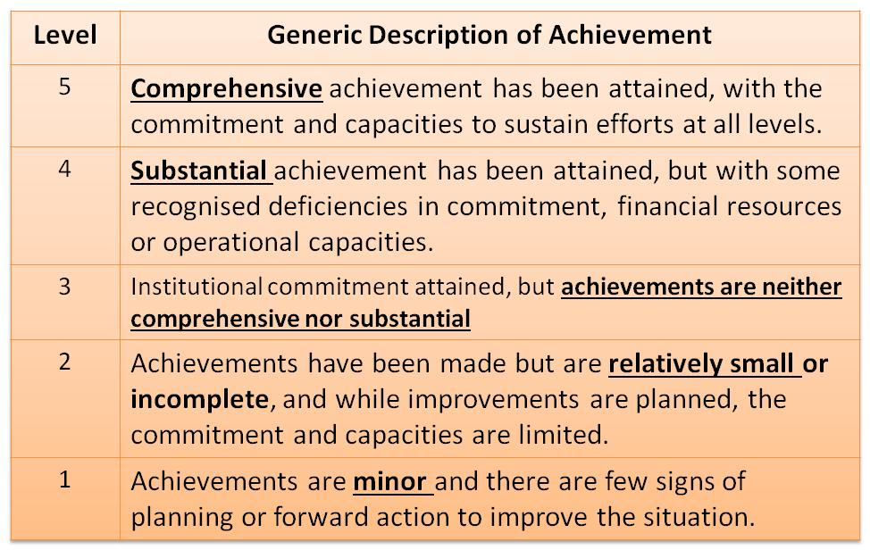
Level of Progress
Priority for Action | Indicators | Level of Progress
PRIORITY FOR ACTION 1 Ensure that disaster risk reduction is a national and local priority with a strong | National policy and legal framework for disaster risk reduction exists with decentralized responsibilities and capacities at all levels | 3
 | Dedicated and adequate resources are available to implement disaster risk reduction plans and activities at all administrative levels | 2
 | Community participation and decentralization are ensured through the delegation of authority and resources to local levels | 3
 | A national multi-sectoral platform for disaster risk reduction is functioning | 3

Slide 10
Level of Progress
Priority for Action | Indicators | Level of Progress
 |  | 07-09 | 09-11
PRIORITY FOR ACTION 1 Ensure that disaster risk reduction is a national and local priority with a strong | National policy and legal framework for disaster risk reduction exists with decentralized responsibilities and capacities at all levels | 3 | 3
 | Dedicated and adequate resources are available to implement disaster risk reduction plans and activities at all administrative levels | 2 | 2
 | Community participation and decentralization are ensured through the delegation of authority and resources to local levels | 3 | 3
 | A national multi-sectoral platform for disaster risk reduction is functioning | 2 | 3

Slide 11
Priority for Action | Indicators | Level of Progress
 |  | 07-09 | 09-11
PRIORITY FOR ACTION 2: Identify, assess and monitor disaster risks and enhance early warning | National and local risk assessments based on hazard data and vulnerability information are available and include risk assessments for key sectors | 2 | 3
 | Systems are in place to monitor, archive and disseminate data on key hazards and vulnerabilities | 1 | 3
 | Early warning systems are in place for all major hazards, with outreach to communities | 1 | 3
 | National and local risk assessments take account of regional / transboundary risks | 2 | 3

Slide 12
Level of Progress
Priority for Action | Indicators | Level of Progress
 |  | 07-09 | 09-11
PRIORITY FOR ACTION 3 Use knowledge, innovation and education to build a culture of safety and resilience at all levels | Relevant information on disasters is available and accessible at all levels, to all stakeholders | 2 | 2
 | School curricula, education material and relevant trainings include disaster risk reduction and recovery concepts and practices | 3 | 3
 | Research methods and tools for multi-risk assessments and cost benefit analysis are developed and strengthened | 2 | 2
 | Countrywide public awareness strategy exists to stimulate a culture of disaster resilience, with outreach to urban and rural communities | 2 | 3

Slide 13
Level of Progress
Priority for Action | Indicators | Level of Progress
 |  | 07-09 | 09-11
PRIORITY FOR ACTION 4 Reduce the underlying risk factors | Disaster risk reduction is an integral objective of environment related policies and plans | 3 | 3
 | Social development policies and plans are being implemented to reduce the vulnerability of populations most at risk | 3 | 2
 | Economic and productive sectorial policies and plans have been implemented to reduce the vulnerability of economic activities | 3 | 2
 | Planning and management of human settlements incorporate disaster risk reduction elements, including enforcement of building codes | 3 | 2

Slide 14
Level of Progress
Priority for Action | Indicators | Level of Progress
 |  | 07-09 | 09-11
PRIORITY FOR ACTION 4 Reduce the underlying risk factors | Disaster risk reduction is an integral objective of environment related policies and plans | 3 | 3
 | Social development policies and plans are being implemented to reduce the vulnerability of populations most at risk | 3 | 2
 | Economic and productive sectorial policies and plans have been implemented to reduce the vulnerability of economic activities | 3 | 2
 | Planning and management of human settlements incorporate disaster risk reduction elements, including enforcement of building codes | 3 | 2
Social Development
Reduce Vulnerability
Building Code

Slide 15
Level of Progress
Priority for Action | Indicators | Level of Progress
 |  | 07-09 | 09-11
PRIORITY FOR ACTION 4 Reduce the underlying risk factors | Disaster risk reduction measures are integrated into post disaster recovery and rehabilitation processes | 2 | 2
 | procedures are in place to assess the disaster risk impacts of major development projects | 2 | 2

Slide 16
Level of Progress
Priority for Action | Indicators | Level of Progress
 |  | 07-09 | 09-11
PRIORITY FOR ACTION 5 Strengthen disaster preparedness for effective response at all levels | Strong policy, technical and institutional capacities and mechanisms for disaster risk management, with a disaster risk reduction perspective are in place | 2 | 3
 | Disaster preparedness plans and contingency plans are in place at all administrative levels | 2 | 3
 | Financial reserves and contingency mechanisms are in place to support effective response and recovery when required | 1 | 3
 | Procedures are in place to exchange relevant information during hazard events and disasters, and to undertake post-event reviews | 2 | 3

Slide 17
Level of Progress
Priority for Action | Indicators | Level of Progress
 |  | 07-09 | 09-11
PRIORITY FOR ACTION 3 Use knowledge, innovation and education to build a culture of safety and resilience at all levels | Relevant information on disasters is available and accessible at all levels, to all stakeholders | 2 | 2
 | School curricula, education material and relevant trainings include disaster risk reduction and recovery concepts and practices | 3 | 3
 | Research methods and tools for multi-risk assessments and cost benefit analysis are developed and strengthened | 2 | 2
 | Countrywide public awareness strategy exists to stimulate a culture of disaster resilience, with outreach to urban and rural communities | 2 | 3

Slide 18
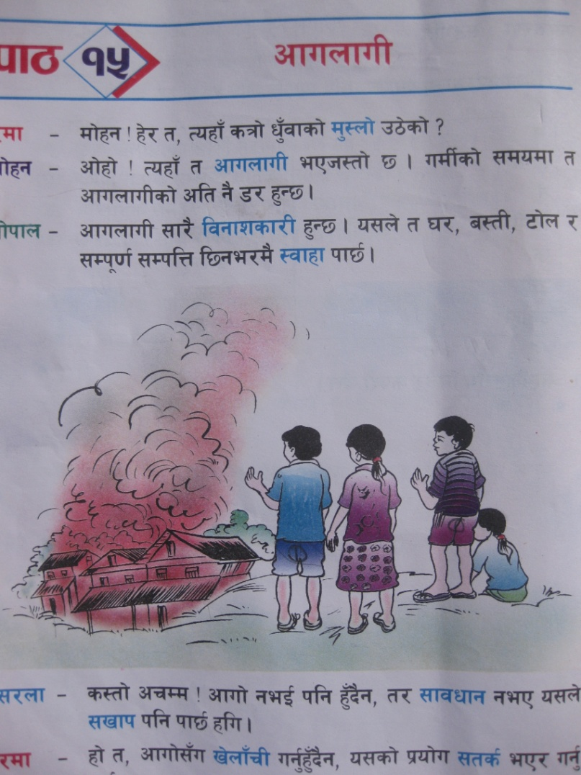
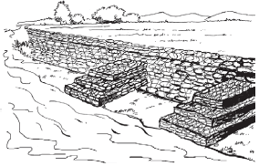
DRR in School Education
Grade 3, Nepali
Grade 5, Science

Slide 19
DRR in School Education
A play in Nepali Text Book (Grade 3) explains
  the causes of fire
  ways to mitigate fire hazard and
  what should be done in case of fire
Grade 3, Nepali
Grade 5, Science

Slide 20
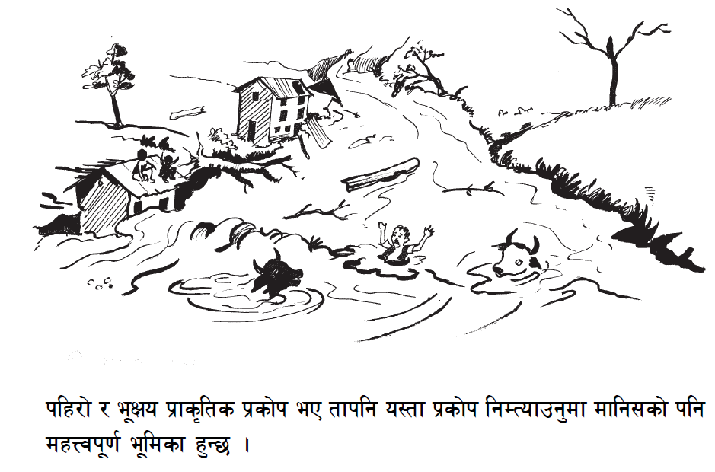
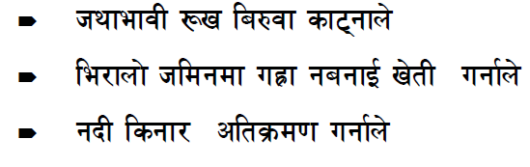
DRR in School Education
Grade 5, Science

Slide 21
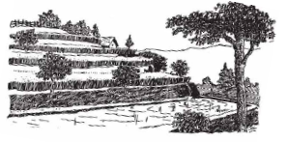
DRR in School Education
Grade 5, Science
Causes of Floods and landslide
Deforestation
Improper Agriculture Practice
Encroachment of river path

Slide 22
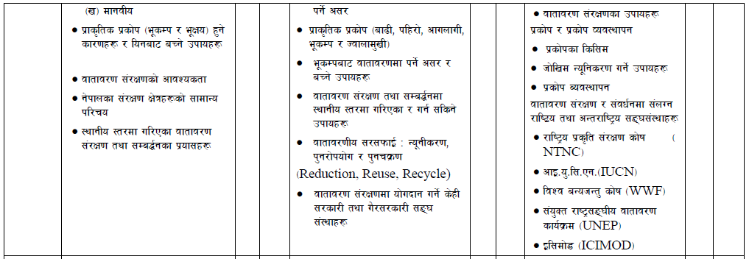
DRR in School Education

Slide 23
DRR in School Education
Grade 6 | Grade 7 | Grade 8
Causes of Natural Disasters (Earthquake and Landslide) and ways to mitigate the risk | Natural Disasters (Flood, Landslide, Fire, Earthquake and Volcano) | Disaster and Disaster Risk Reduction Measures
 | Effects of earthquake and risk reduction measures | Types of disasters and disaster management

Slide 24


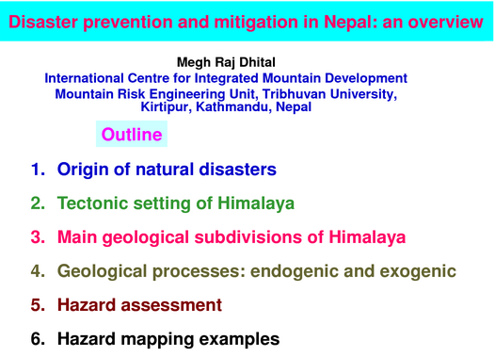
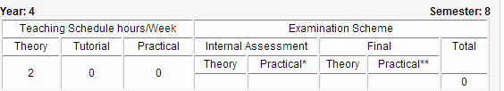
DRR in Higher Education
Himalayan Cryosphere, Climate and Disaster Research Center (HiCCDRC)
Mountain Risk Engineering Unit
Department of Geology, Tribhuvan Unviersity
Bachelor in Civil Engineering, Purbanchal University

Slide 25
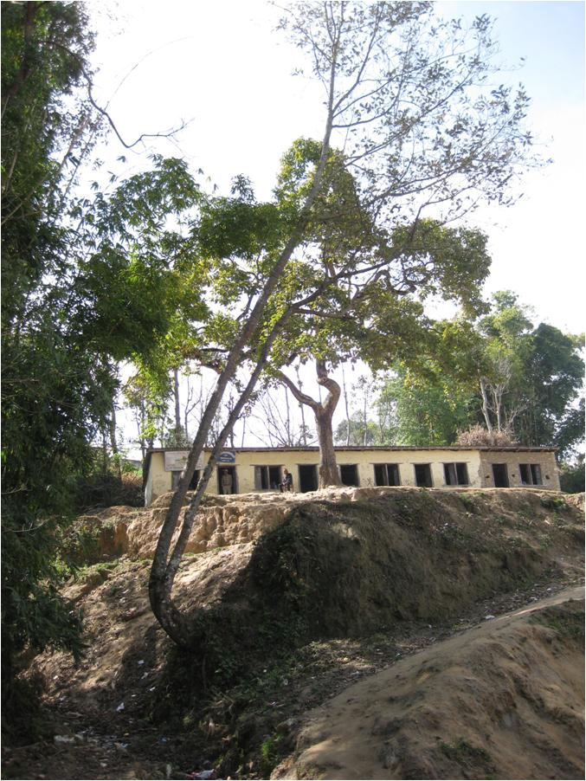

Know the risk and take action before it’s too late !

Slide 26
Thank You

